Slide 1
Thank You !
bonfirehealth.com

Slide 2
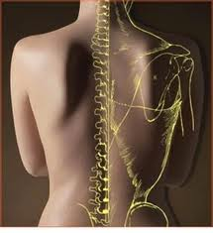
Bullet Proof Advanced Spinal Care Class
featuring
Dr. Stephen Franson

Slide 3
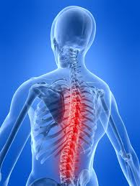
Understanding Back Pain
What CAUSES Back Pain
What can you do to STOP IT

Slide 4
3 LEGGED STOOL
Adjustments in Rhythm
Break Bad Habits
Exercise to Strengthen

Slide 5
How bad is it?

Slide 6
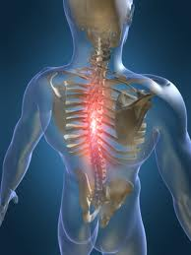
LOW BACK PAIN
TIGHT MUSCLES
LOST R.O.M.
STIFFNESS
LEG PAIN
SWELLING
BURNING
NUMBNESS

Slide 7
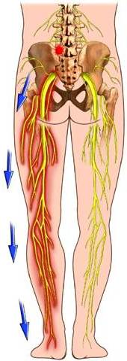
SCIATICA
Sciatic Nerve irritation causing
pain, numbness and tingling into your buttocks, legs and feet

Slide 8
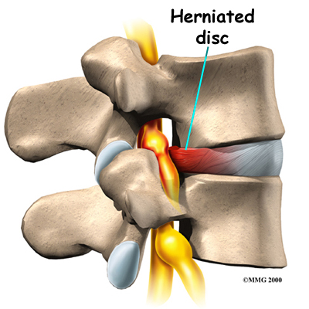
Disc Herniation

Slide 9
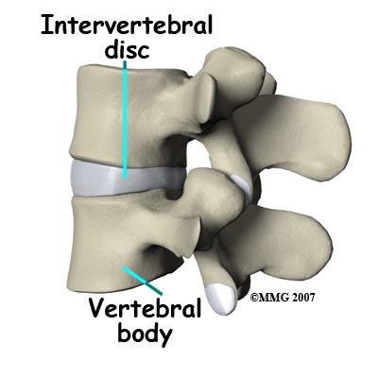

Slide 10
SUBLUXATION
JOINT MISALIGNMENT
SOFT TISSUE DAMAGE
INFLAMMATION / NERVE IRRITATION
MUSCLE SPASM and PAIN
LOST IMBIBITION
JOINT FIXATION
“MOVEMENT DEFICIENCY SYNDROME”
TOXIC GLOBAL PHYSIOLOGY

Slide 11
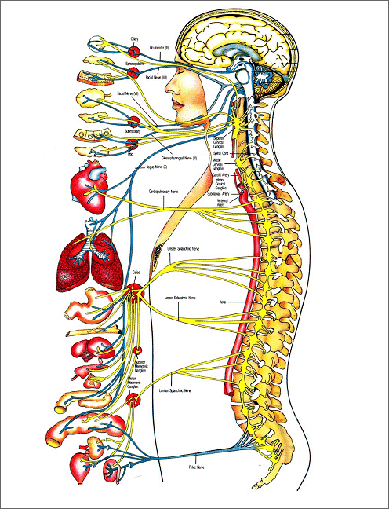
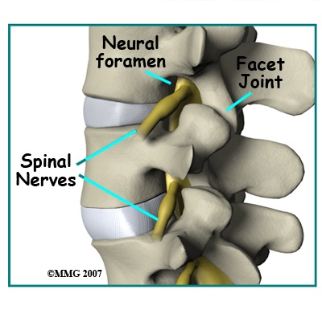
NERVE SUPPLY

Slide 12
Less than 10% of nerves
sense
pain
Windsor study
Notes:
Most aware of subluxations when they cause pain
Only about 10% of body nerves are pain-sensing
What if controlling nerve impulses were reduced to only 80% of normal?
What if distorted nerve impulses caused organs to always race at full throttle?
Subluxations that interfere with Dr. You are more serious than headaches
Could partial, long-standing nerve interference be a factor in cancer?

Slide 13
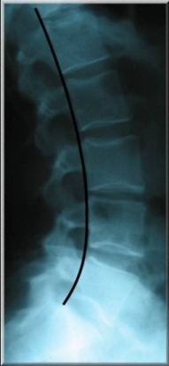
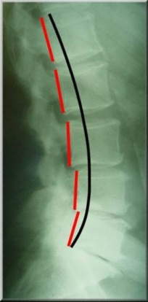
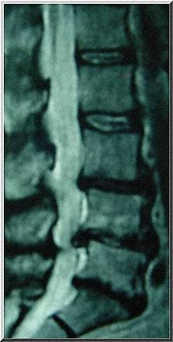
Lateral Lumbar X-Rays & M.R.I.
Normal
Abnormal
“Slipped Disc” a.k.a. Disc Herniation

Slide 14
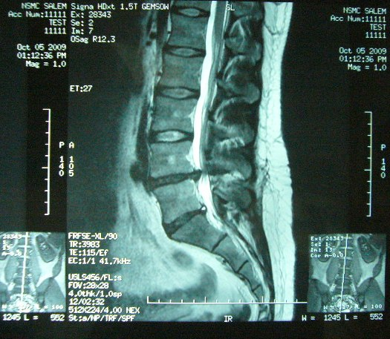
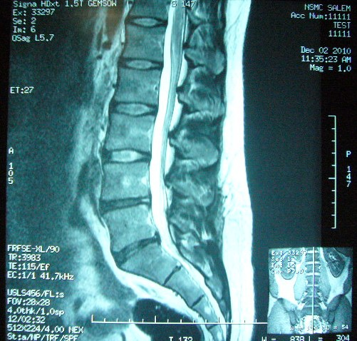
Prior to Chiropractic Care:
“Pre” MRI
After Chiropractic Care:
“Post” MRI

Slide 15
ALLOPATHIC OPTIONS
HEAT AND BED REST
DRUGS
PHYSICAL THERAPY
STEROID INJECTIONS
PAIN MANAGEMENT
SURGERY
ALTERNATIVE THERAPIES?

Slide 16
ALLOPATHIC OPTIONS
HEAT AND BED REST
DRUGS
PHYSICAL THERAPY
STEROID INJECTIONS
PAIN MANAGEMENT
SURGERY
ALTERNATIVE THERAPIES?

Slide 17
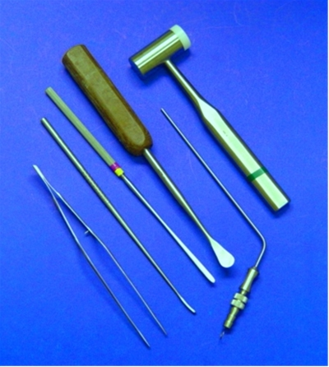
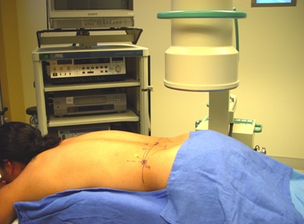
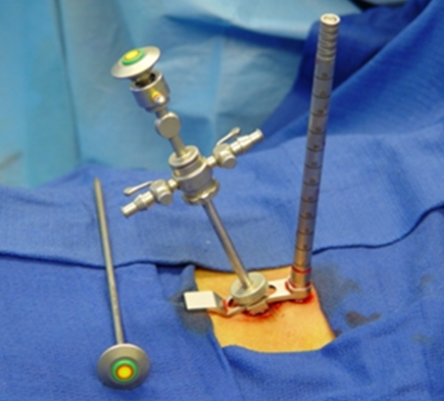
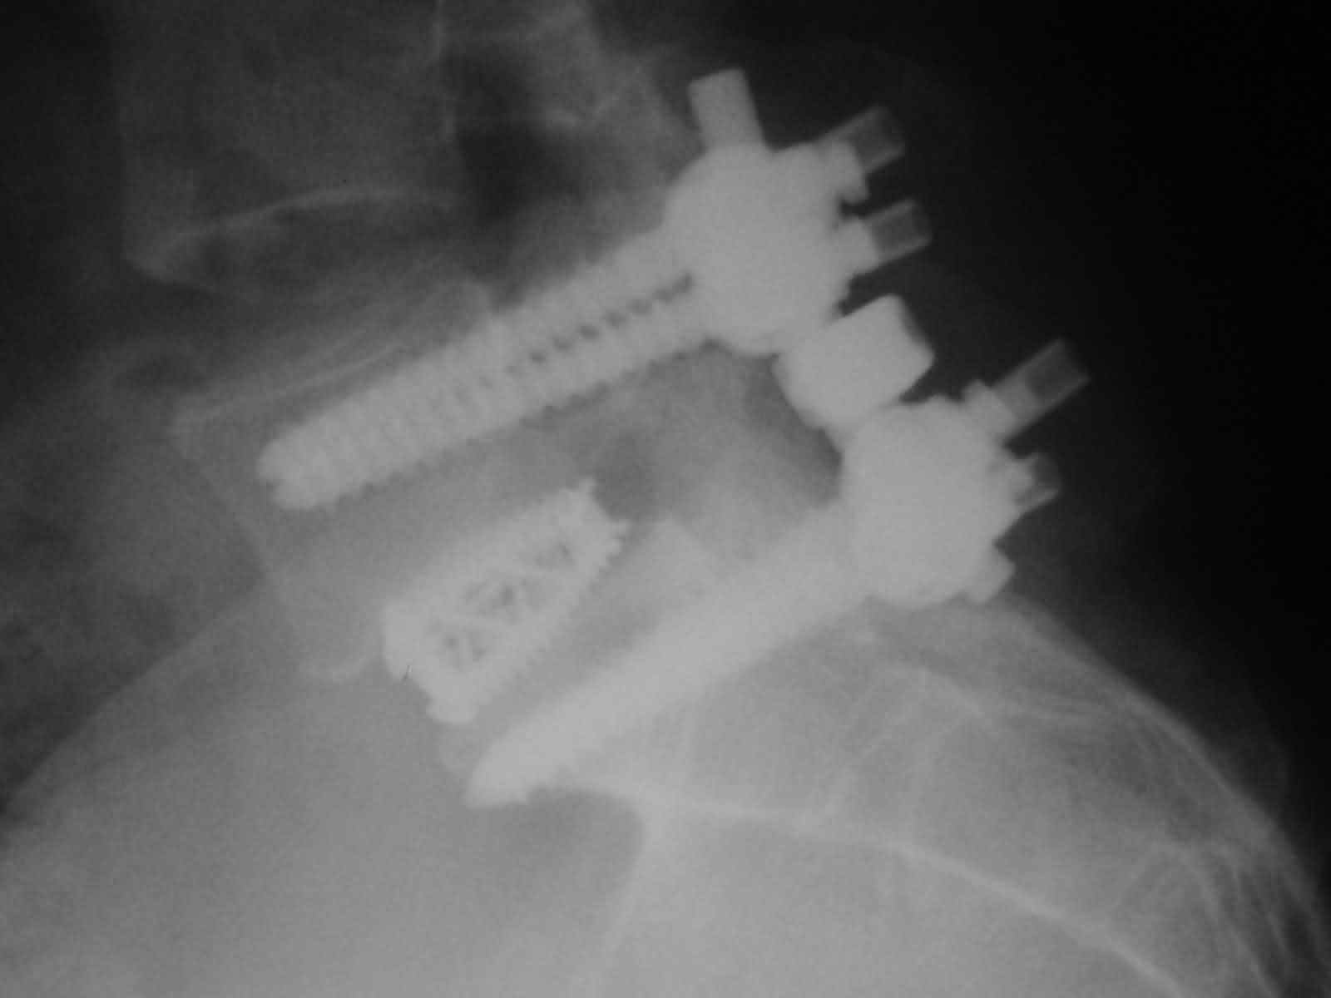
SURGERY?

Slide 18
Ask Questions
What are the RISKS of this procedure?
The COSTS involved?
What are my expected OUTCOMES?
May I INTERVIEW 10 of your patients?
What does the RESEARCH say?
What are my OPTIONS?
Is this treating my symptoms or correcting the CAUSE of my problem?

Slide 19
3 LEGGED STOOL
Adjustments in Rhythm
Break Bad Habits
Exercise to Strengthen

Slide 20
CORRECTIVE CARE
Specific Adjustments
Correct Cause
In Rhythm
“I’ve tried everything...”

Slide 21
CORRECT HABITS
Mindfulness
Consistency
Sit, Stand, Sleep
“If you keep doing what you’ve been doing...”

Slide 22
PROPER EXERCISE
Functional
Technique
Targeted
“Train movements, not muscles.”

Slide 23
3 LEGGED STOOL
Adjustments in Rhythm
Break Bad Habits
Exercise to Strengthen

Slide 24
4 Pit Classes
Spinal Assessment
Warm-up / Cool Down and Flexibility
Level 1 Core Strengthening
Level 2 Core Strengthening

